Slide 1
بسم الله الرحمن الرحیم
ارائه‌ی مقاله‌ی پژوهشی: تحلیل بیوانفورماتیکی و شناسایی نشانگرهای زیستی زمینه‌ای که به طور بالقوه، رینیت آلرژیک و اتوفاژی را به یکدیگر مرتبط می‌سازند.
https://doi.org/10.1038/s41598-024-78375-6
ارائه‌دهنده: مرتضی قاسمی نافچی

Slide 2
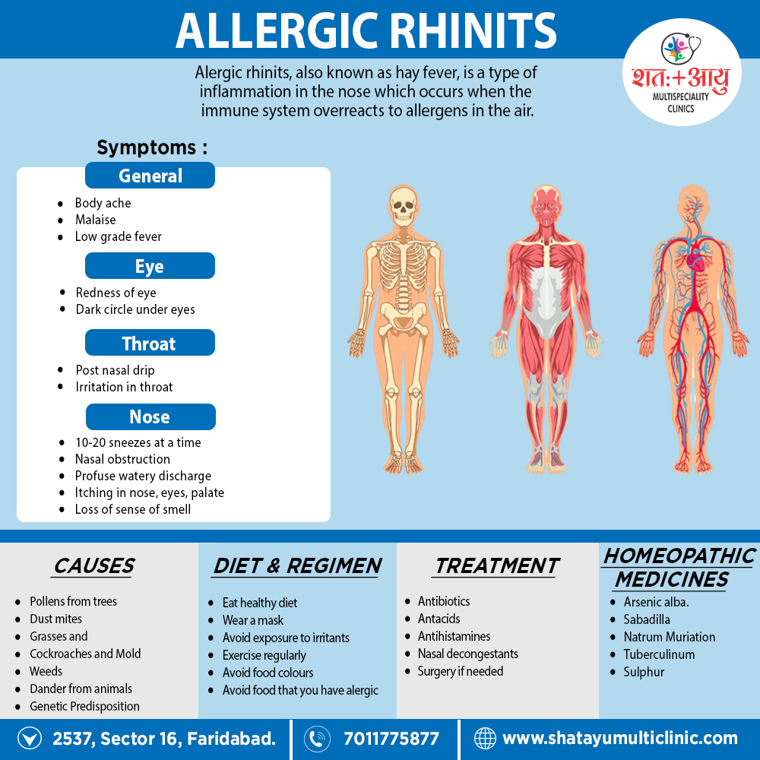

Slide 3
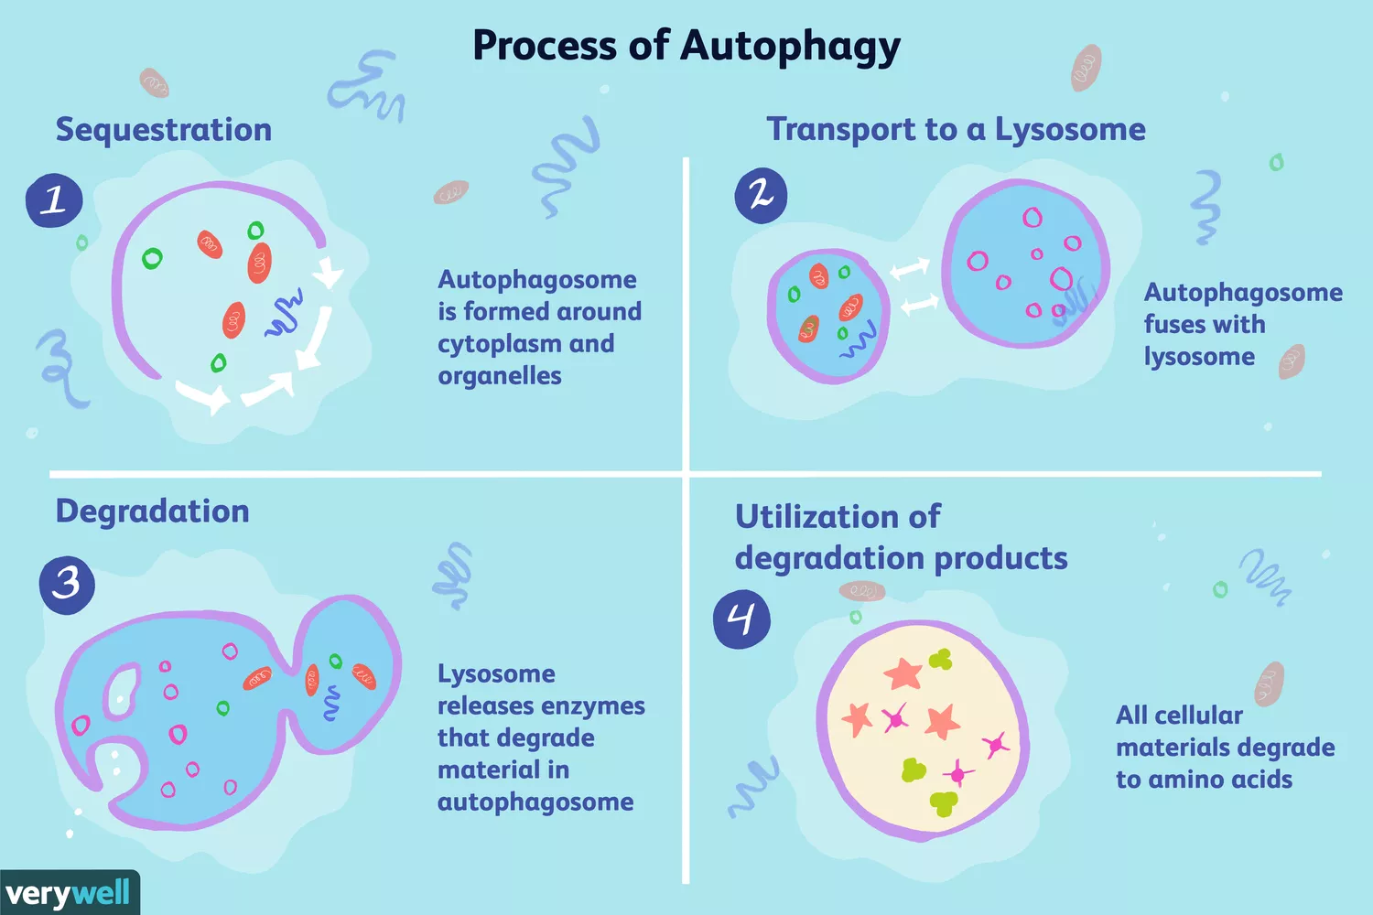

Slide 4
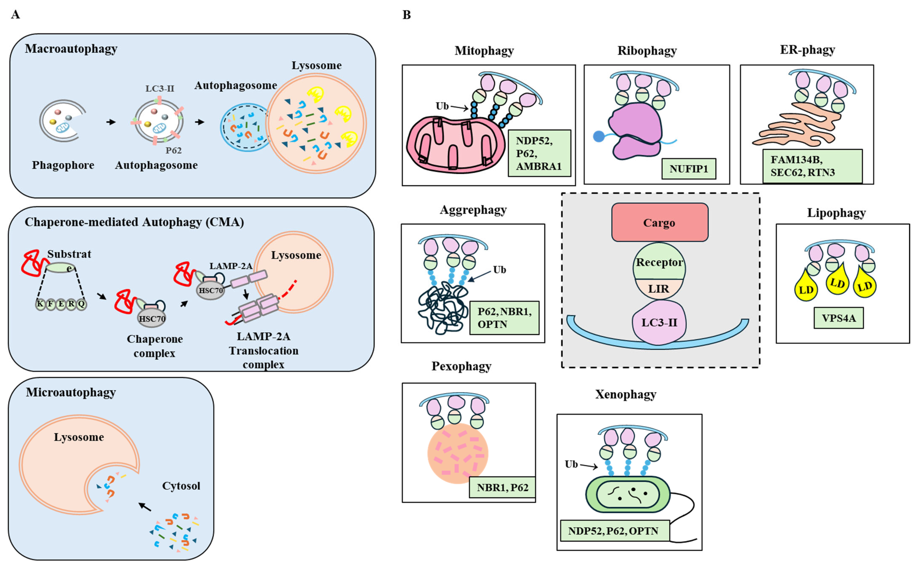
(A) Main types of autophagy include macroautophagy, microautophagy, and chaperone-mediated autophagy. Macroautophagy involves the formation of an autophagosome, a double membrane vesicle that engulfs and sequesters to deliver cargo to a lysosome for degradation. In microautophagy, lysosomal membrane is invaginated to uptake cargo. Chaperone-mediated autophagy (CMA) involves the transport of individual unfolded protein into a lysosome with the help of chaperone proteins and lysosomal receptors. Chaperone proteins, such as heat shock cognate protein 70 (HSC70) mediate CMA. Lysosomal-associated membrane protein-2A (LAMP-2A) binds to hsc70 protein and substrate to degrade the substrate. Arrows denote the direction of reaction. (B) Selective autophagy involves the formation of an autophagosome, which then fuses with lysosome to degrade intracellular contents. Selective autophagy is different from bulk autophagy in that selective autophagy focuses on particular substrates, such as damaged organelles (mitochondria, ER, peroxisome), protein aggregates (aggrephagy), or pathogens (xenophagy). Unlike bulk (non-selective) autophagy, selective autophagy utilizes selective autophagy receptors. Selective autoaphgy receptors bind to LC3-II via LC3-interatiing regin (LIR). LD denotes lipid droplet. Selective autophagy receptors are shown: FAM134B, Family With Sequence Similarity 134 Member B; NBR, Neighbor of BRCA1 gene 1; NUFIP1, Nuclear FMR (Fragile X Messenger Ribonucleoprotein 1) interacting protein 1; RTN3, Reticulon-3; SEC62, Translocation Protein SEC62; VPS4A, Vacuolar Protein Sorting 4 Homolog A. Ub denotes ubiquitinated proteins. https://doi.org/10.3390/ijms26199765

Slide 5
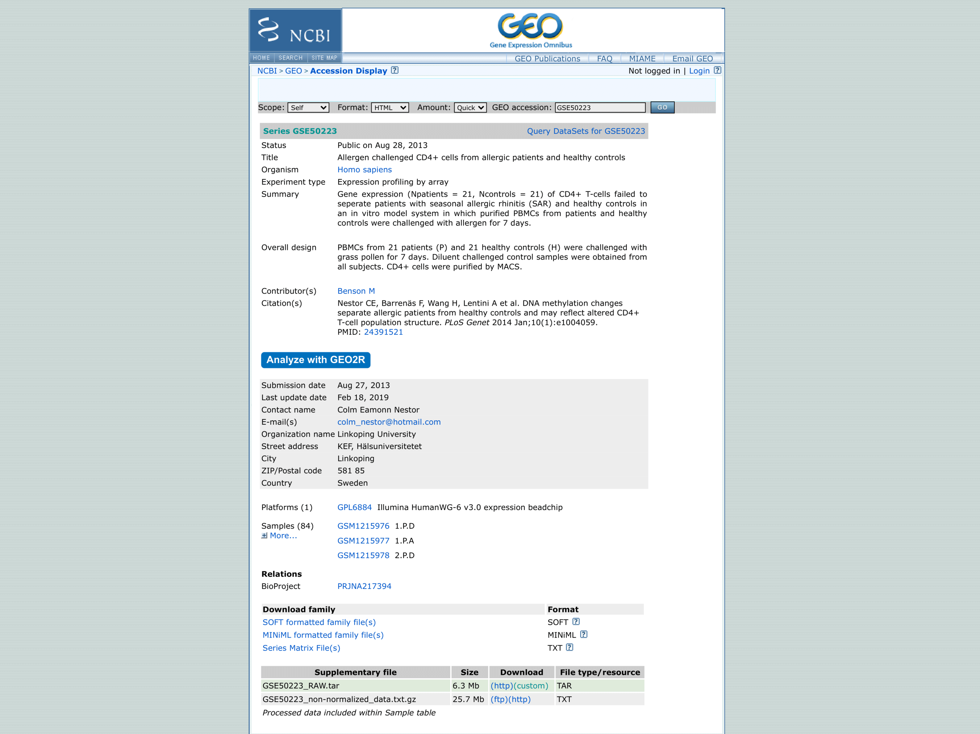

Slide 6
library(GEOquery)
gse <- getGEO("GSE50223", GSEMatrix = TRUE)
Found 0 file(s)
NA
HTTP 404 Not Found.File stored at:
C:\Users\PARSPO~1\AppData\Local\Temp\RtmpagpiCT/NA
Error in downloadFile(url, destfile = destfile, mode = "wb") :
Failed to download C:\Users\PARSPO~1\AppData\Local\Temp\RtmpagpiCT/NA!

Slide 7
library(limma)
library(edgeR)
exprs_raw <- read.table("D:/GSE50223_non-normalized_data.txt.gz",
header = TRUE, sep = "\t", quote = "", comment.char = "")
exprs_norm <- normalizeBetweenArrays(exprs_raw, method = "quantile")
signal_cols <- grep("AVG_Signal", colnames(exprs_raw))
exprs_matrix <- as.matrix(exprs_raw[, signal_cols])
rownames(exprs_matrix) <- exprs_raw$ID_REF
exprs_norm <- normalizeBetweenArrays(exprs_matrix, method = "quantile")
exprs_matrix: ماتریس عددی شدت‌های خام
exprs_norm: مقادیر عبارت نرمال‌شده، آماده برای تحلیل‌های بعد

Slide 8
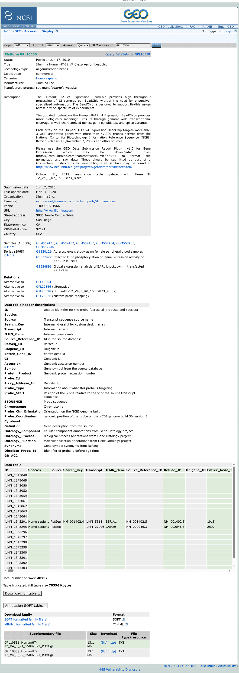

Slide 9
gpl <- read.table("D:/GPL10558-50081.txt",
header = TRUE, sep = "\t",
quote = "", comment.char = "", fill = TRUE)
library(GEOquery)
gpl <- getGEO("GPL10558", AnnotGPL = TRUE)
gpl_table <- Table(gpl)
exprs_df <- data.frame(ID = rownames(exprs_norm), exprs_norm)
exprs_annot <- merge(gpl_table[, c("ID", "Gene symbol")],
exprs_df,
by = "ID")
gpl6884 <- getGEO("GPL6884", AnnotGPL = TRUE)
gpl6884_table <- Table(gpl6884)
exprs_df <- data.frame(ID = rownames(exprs_norm), exprs_norm)
exprs_annot6884 <- merge(gpl6884_table[, c("ID", "Gene symbol")],
exprs_df,
by = "ID")

Slide 10
gse <- getGEO("GSE50223", GSEMatrix = TRUE)
length(gse)
gse_data <- gse[[1]]
save(gse_data, file = "D:/gse_data.RData")
gsedatacsv = pData(gse_data)
write.csv(gsedatacsv, file = "D:/gsedatacsv.csv", row.names = TRUE)
pheno <- pData(gse_data)
colnames(pheno)
table(pheno$`diagnosis:ch1`)
diagnosis <- factor(pheno$`diagnosis:ch1`, levels = c("H", "P"))
challenge <- factor(pheno$`challenge:ch1`, levels = c("Diluent", "Allergen"))
design <- model.matrix(~ diagnosis * challenge)
design

Slide 11
diagnosisv <- factor(pheno$`diagnosis:ch1`, levels = c("H", "P"))
challengev <- factor(pheno$`challenge:ch1`, levels = c(“Diluent", “Allergen"))
subjectv <- factor(pheno$`subject:ch1`)
designv <- model.matrix(~ diagnosisv * challengev)
corfit <- duplicateCorrelation(exprs(gse_data), design, block = subjectv)
fit <- lmFit(exprs(gse_data), designv, block = subjectv, correlation = corfit$consensus)
fitfinal <- eBayes(fit)
results <- topTable(fitfinal, coef = "diagnosisP:challengeAllergen", number = Inf)
deg <- results[results$P.Value < 0.05 & abs(results$logFC) > 0, ]
up <- sum(deg$logFC > 0)
Up = 2393
down <- sum(deg$logFC < 0)
Down = 1886

Slide 12
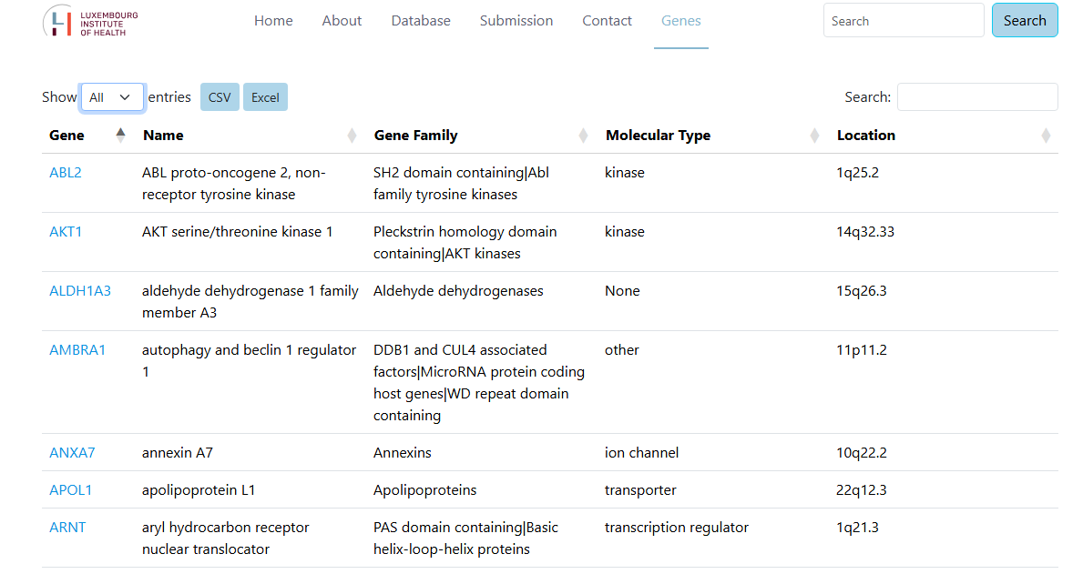

Slide 13
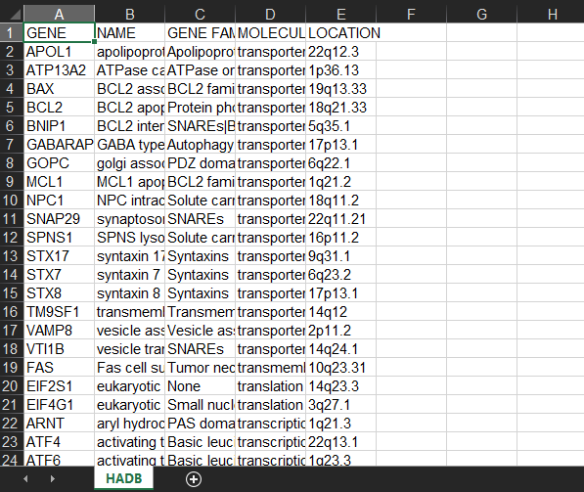

Slide 14
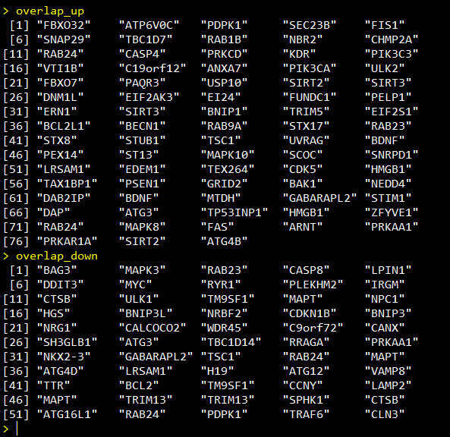

Slide 15
Regulation | New List Genes | Found in overlap_up | Found in overlap_down | Unique/Different
Up | PIK3C3, BECN1, EDEM1, SIRT2, UVRAG, ULK2, DLC1, EIF2AK3, ZFYVE1, CASP4, PELP | 10 genes | — | DLC1
Down | PEX14, CALCOCO2, CDKN1B, TMEM49, TM9SF1, NPC1, VEGFA, BNIP3, HGS, GABARAPL2 | PEX14 (conflict), GABARAPL2 (conflict) | 7 genes | TMEM49, VEGFA

Slide 16
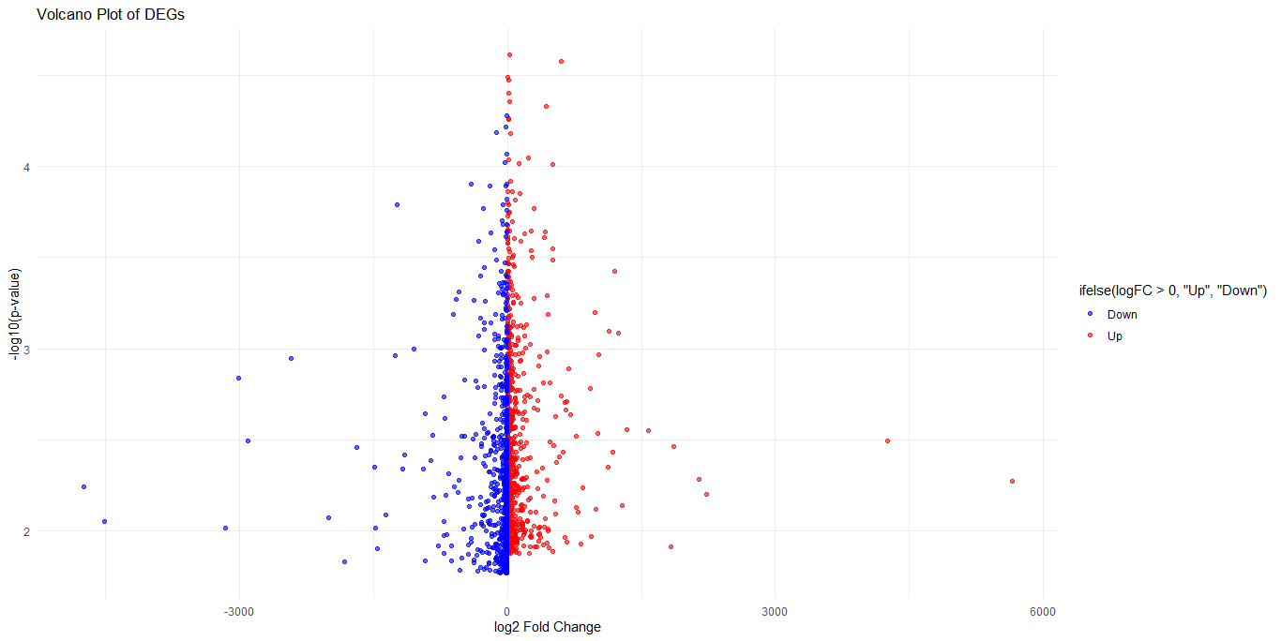

Slide 17
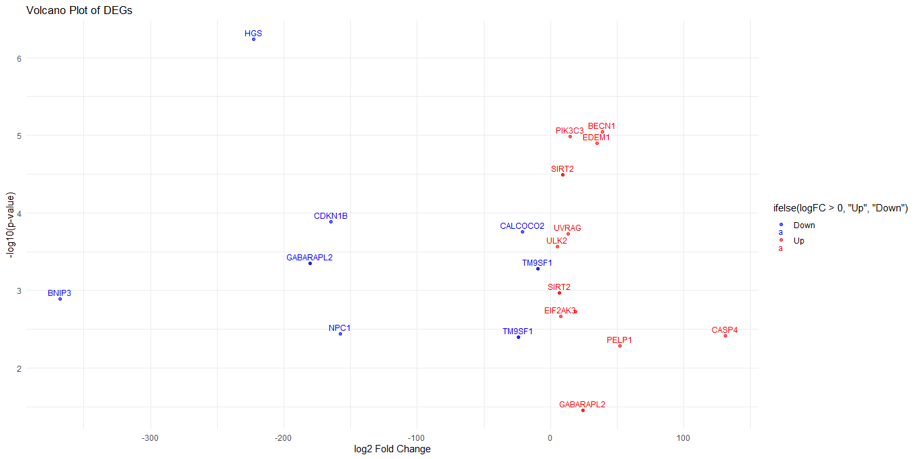

Slide 18
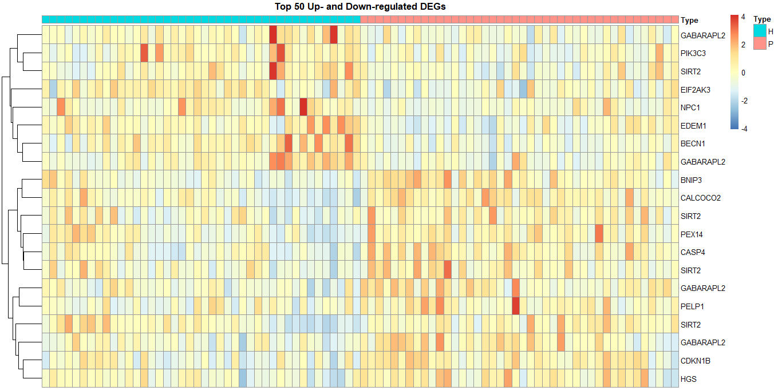

Slide 19
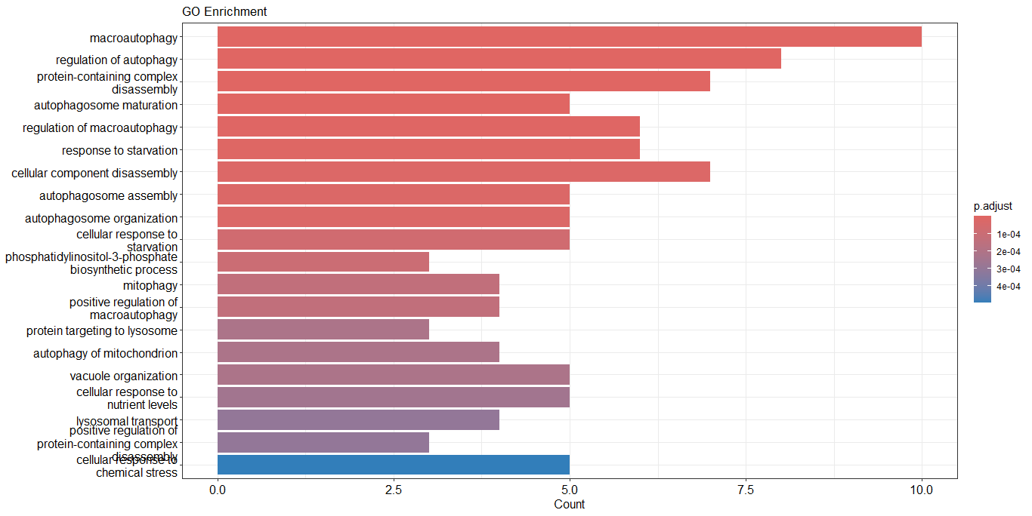

Slide 20
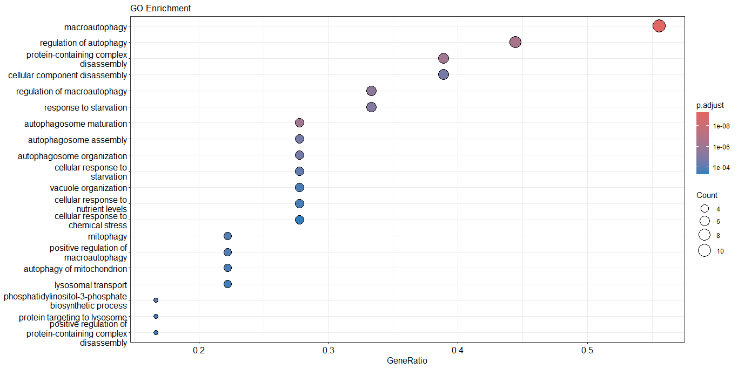

Slide 21
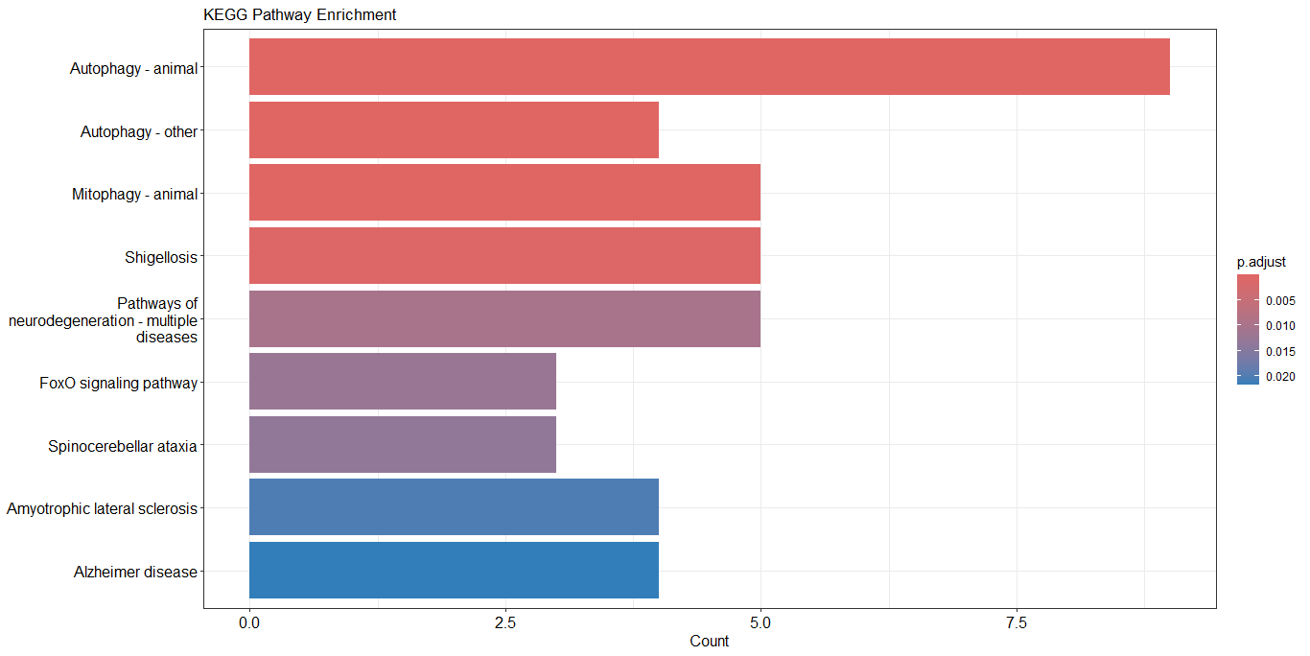

Slide 22
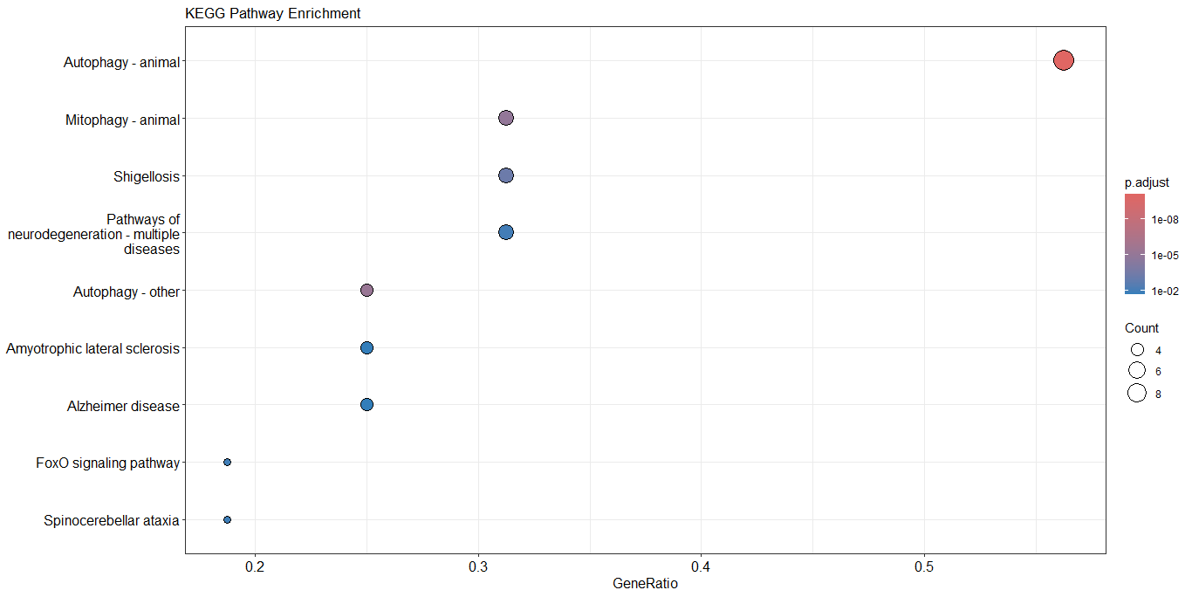

Slide 23
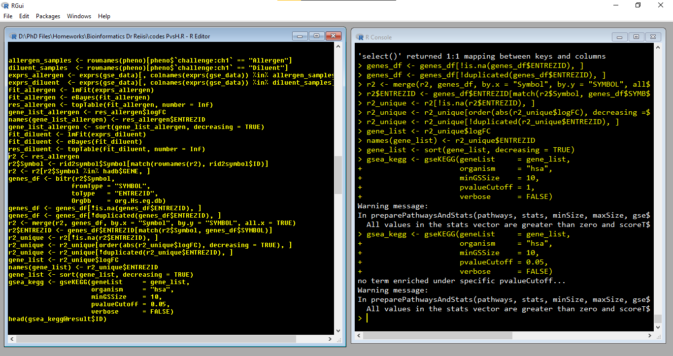

Slide 24
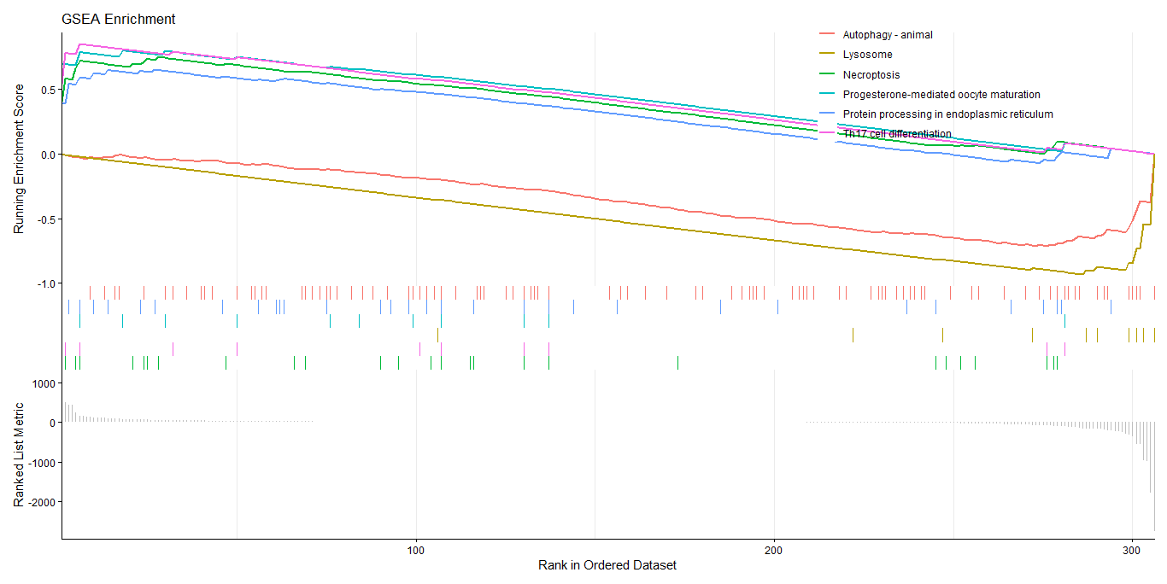

Slide 25
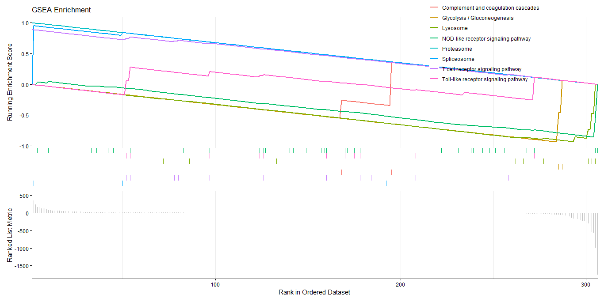

Slide 26
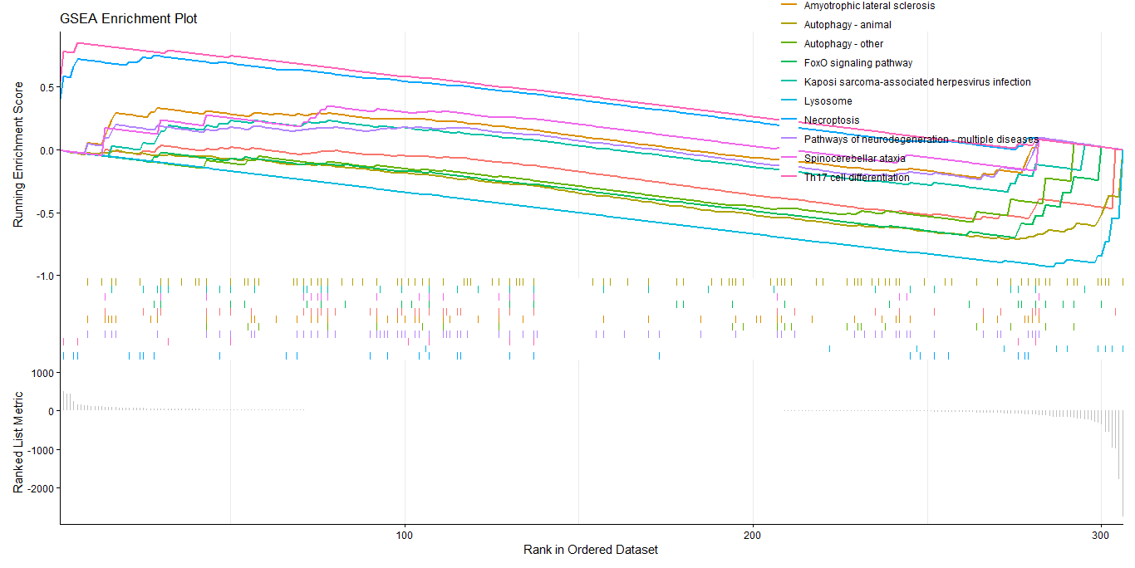

Slide 27
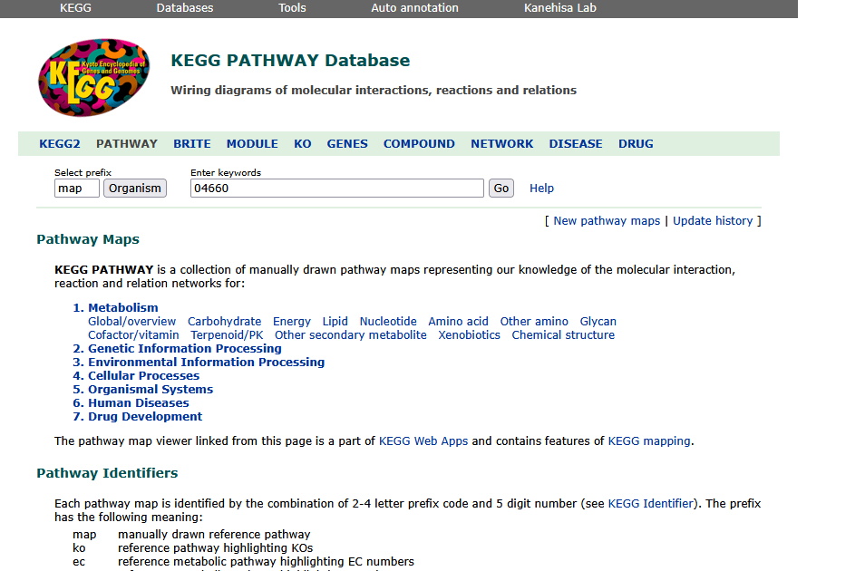

Slide 28
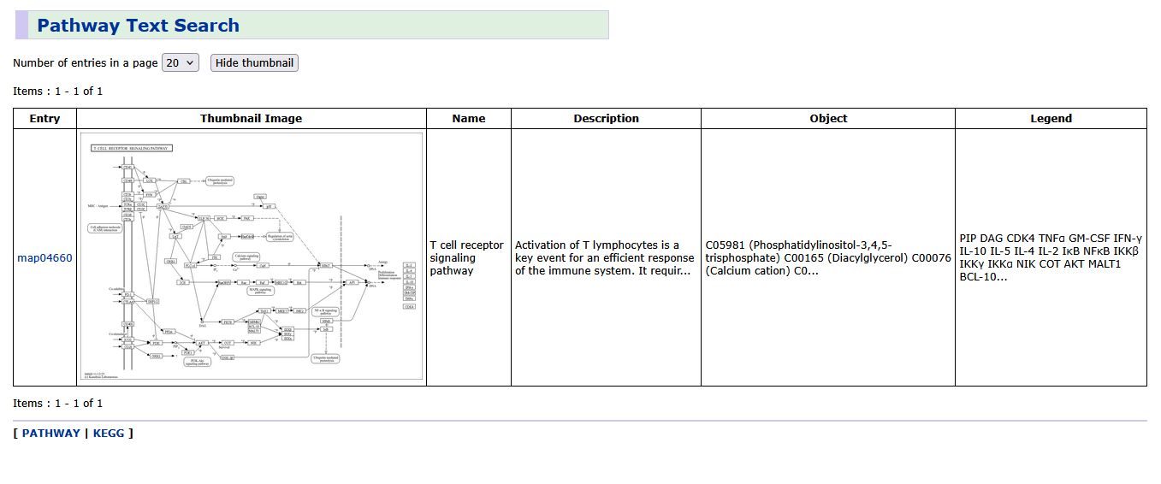

Slide 29
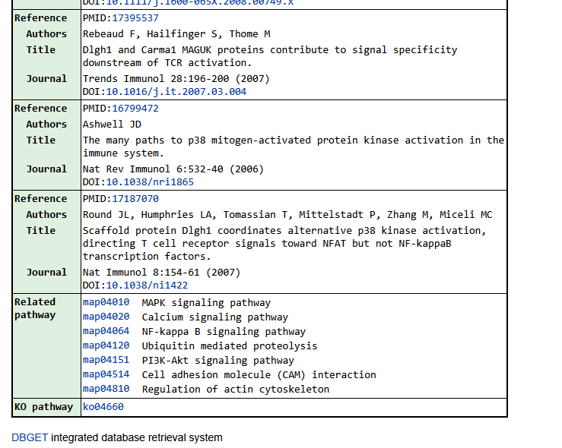

Slide 30
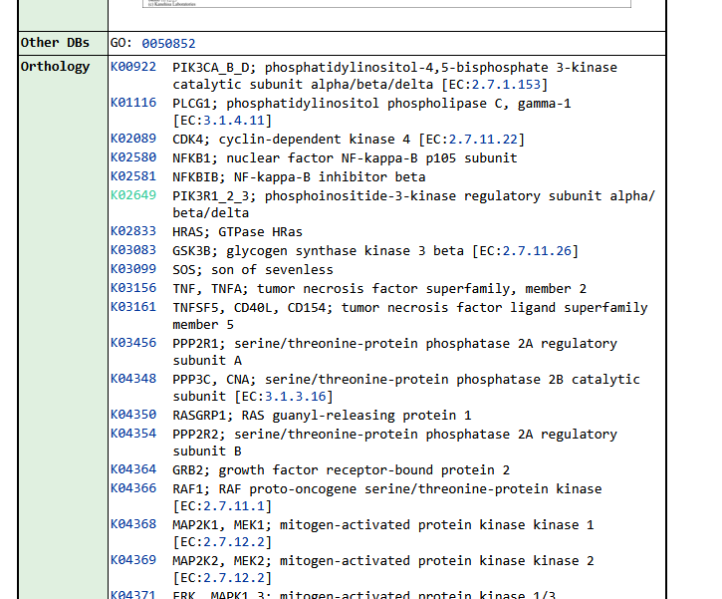

Slide 31
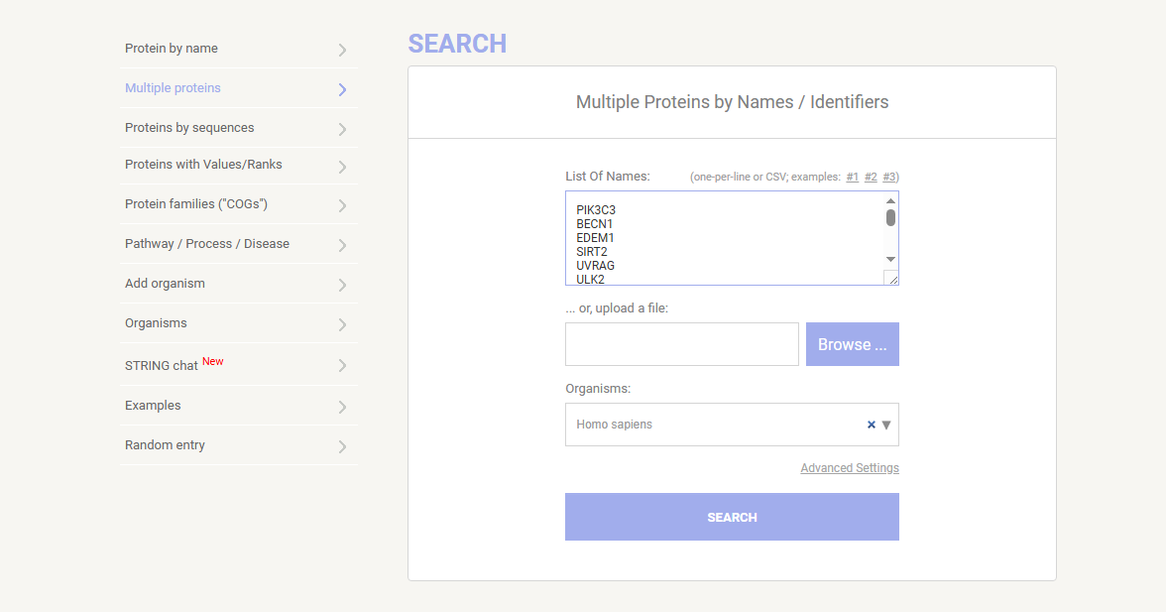

Slide 32
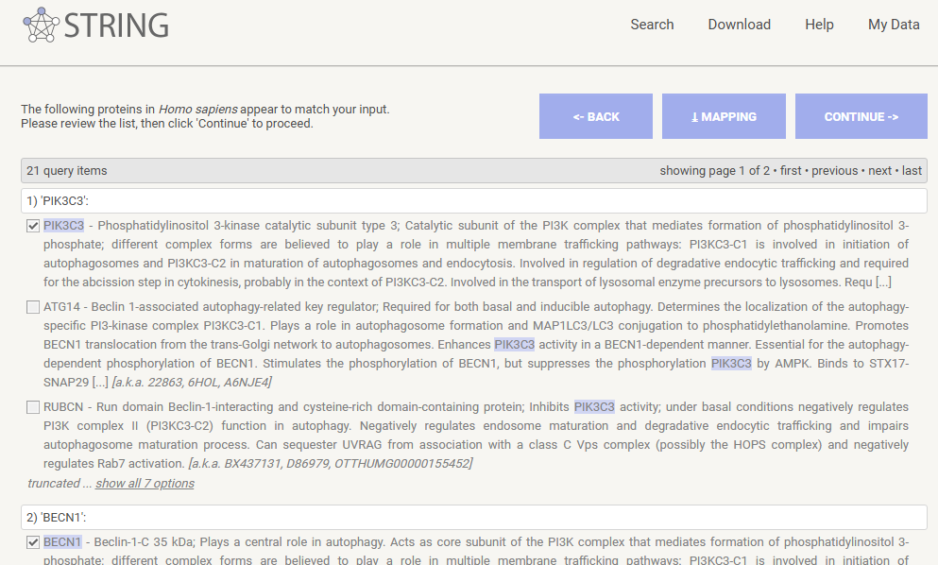

Slide 33
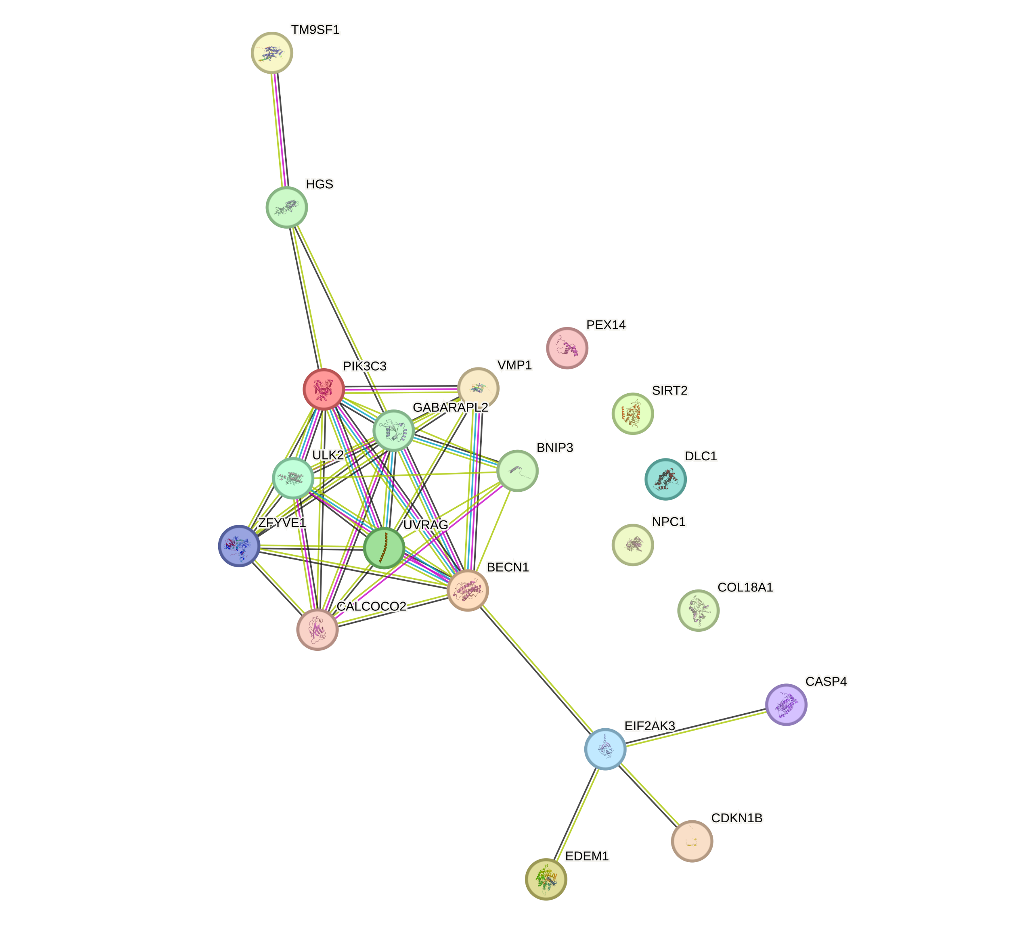

Slide 34
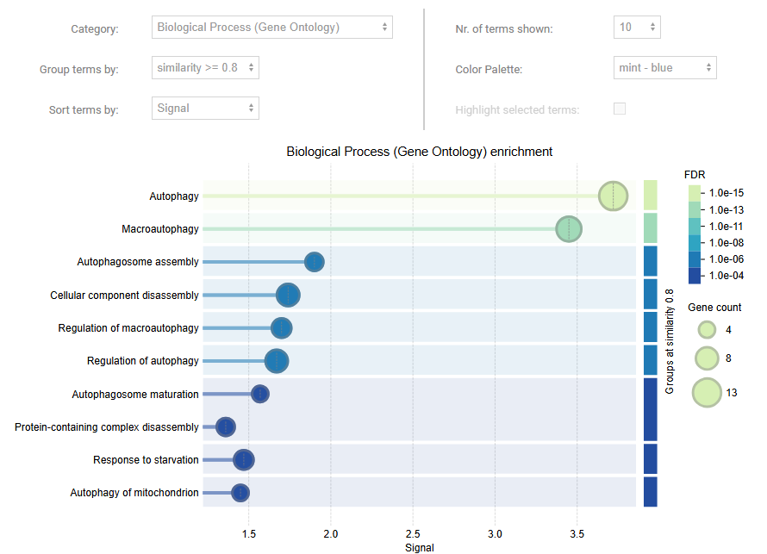

Slide 35
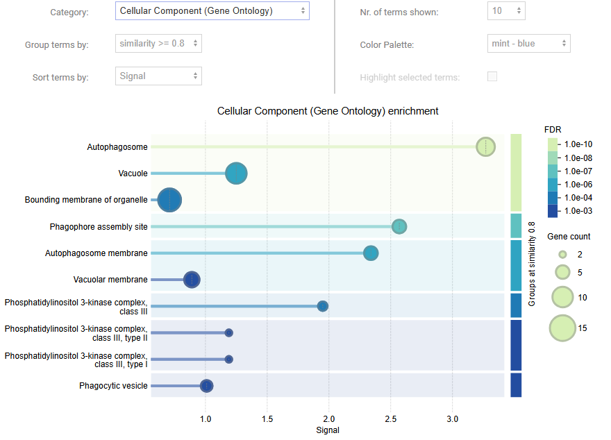

Slide 36
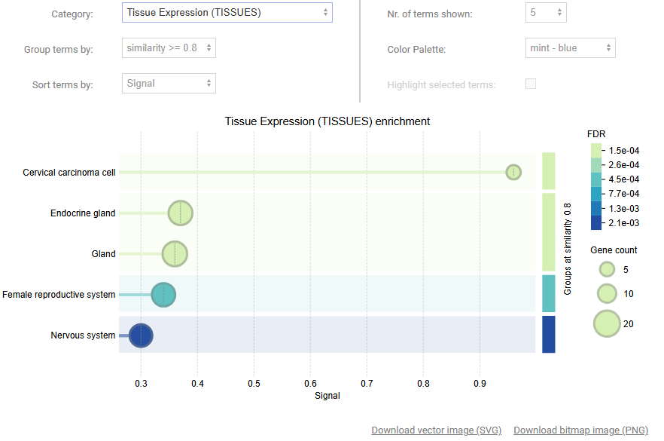

Slide 37
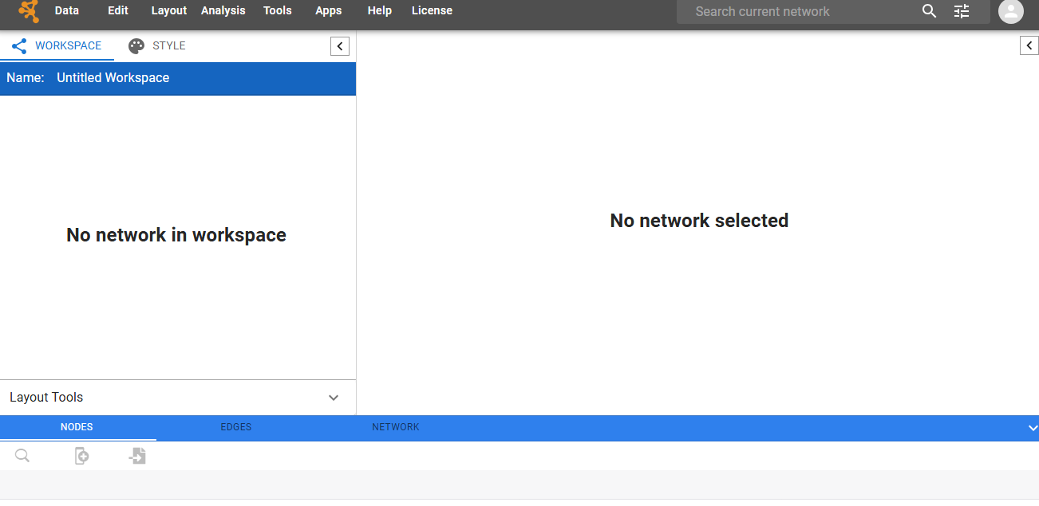

Slide 38
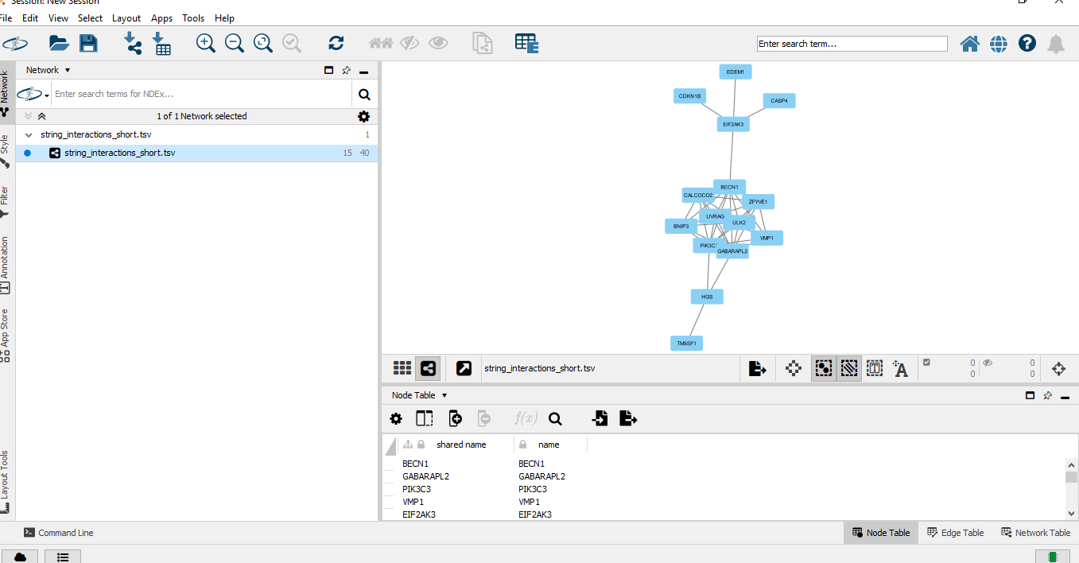

Slide 40
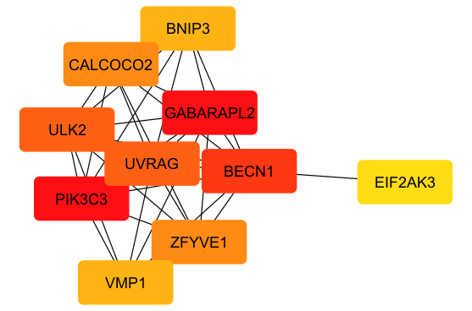

Slide 41
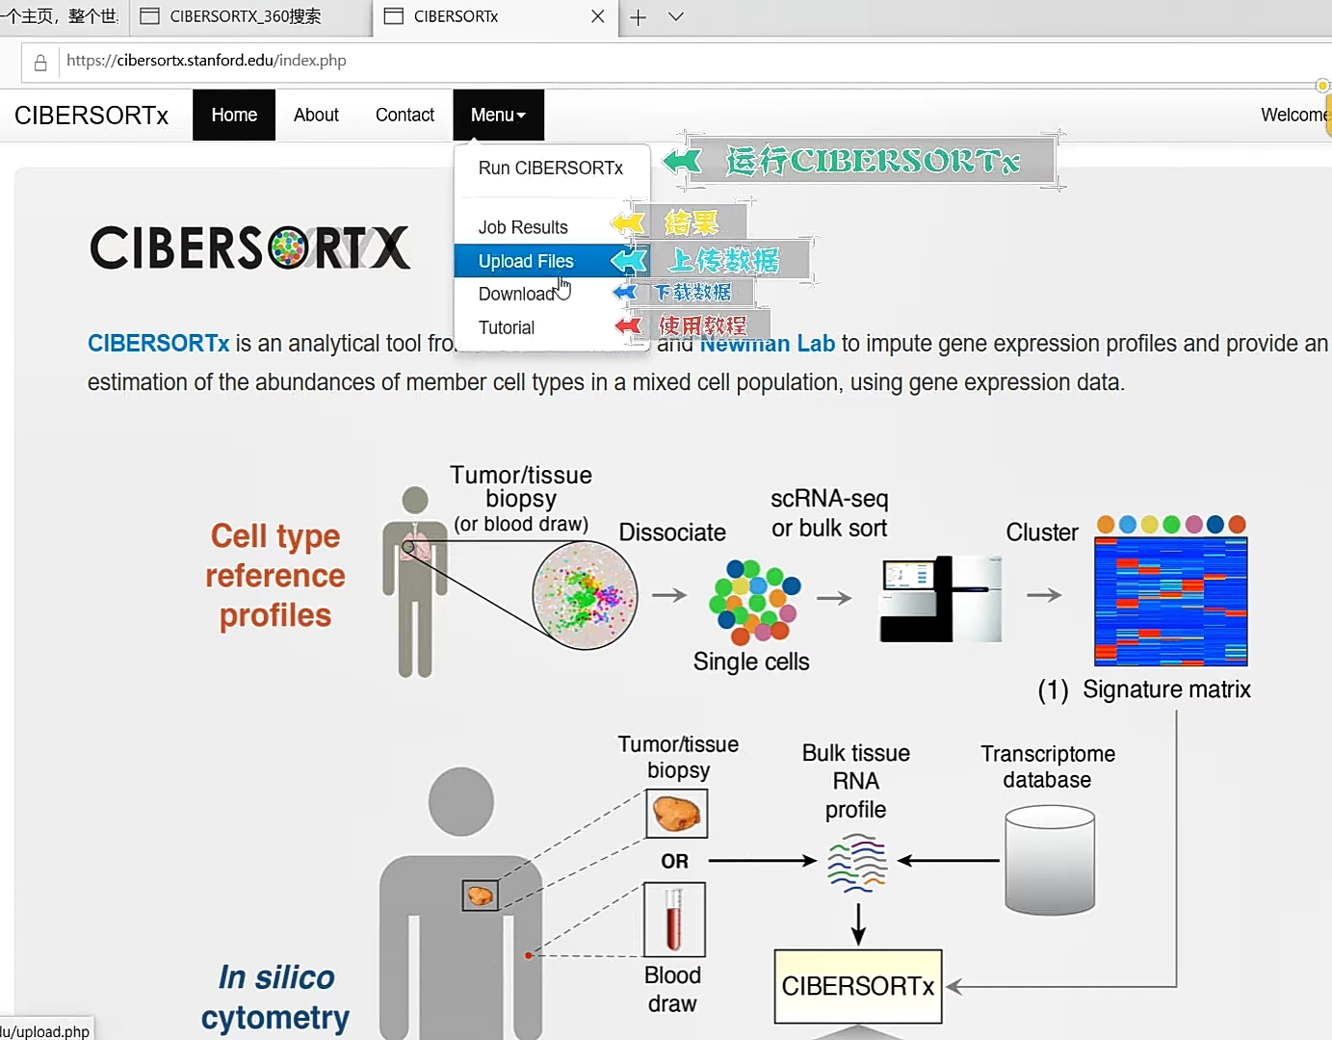

Slide 42
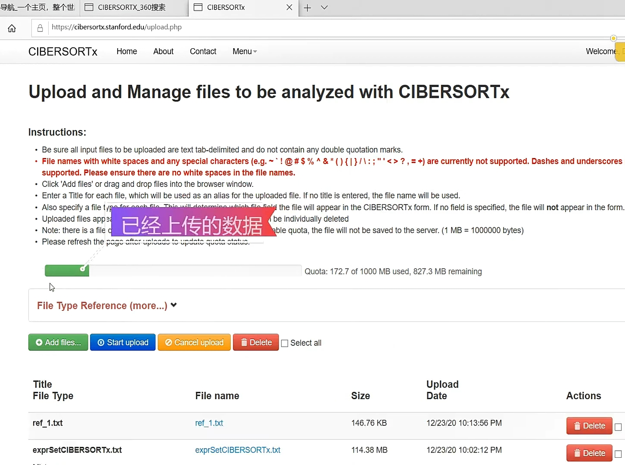

Slide 43
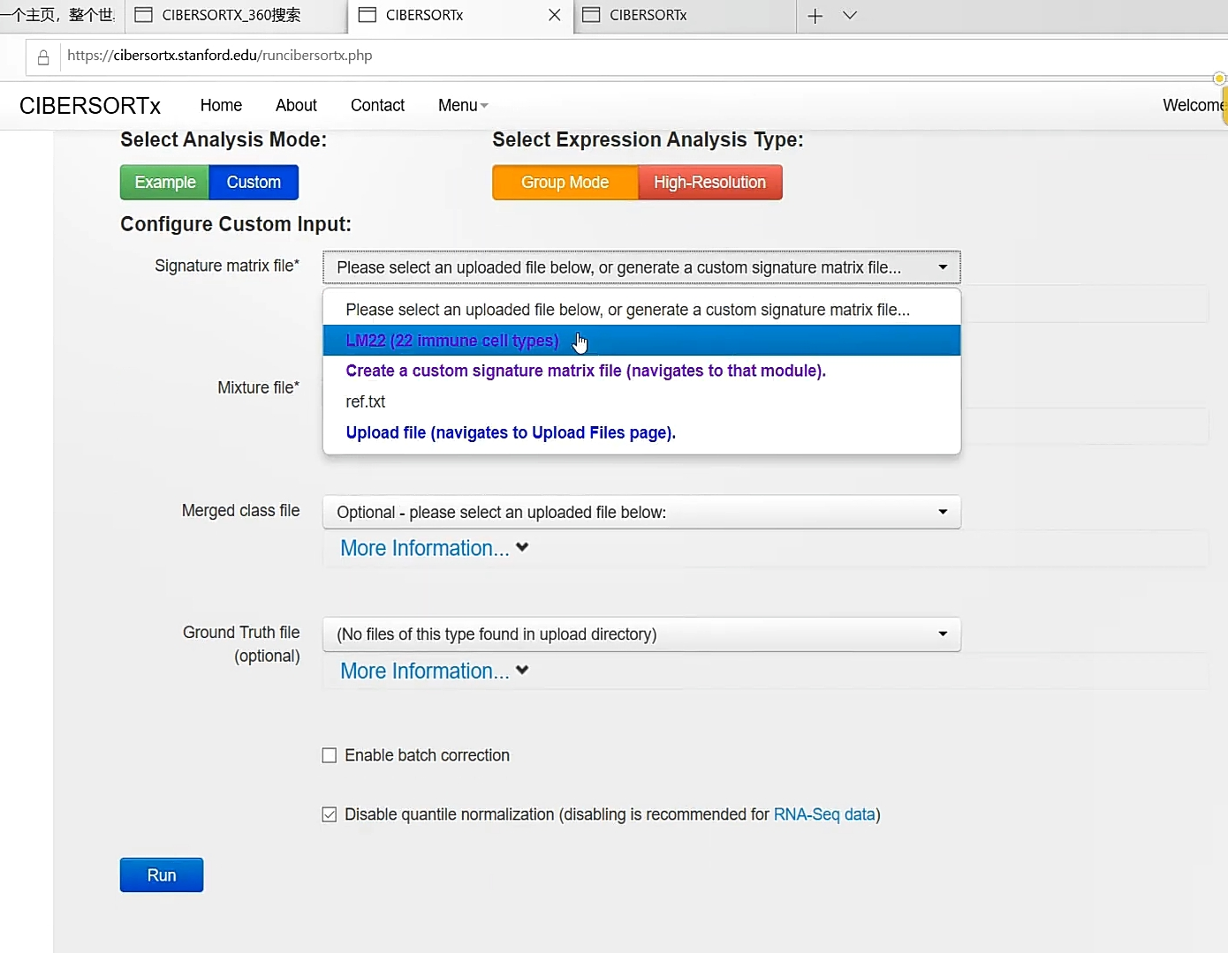

Slide 44
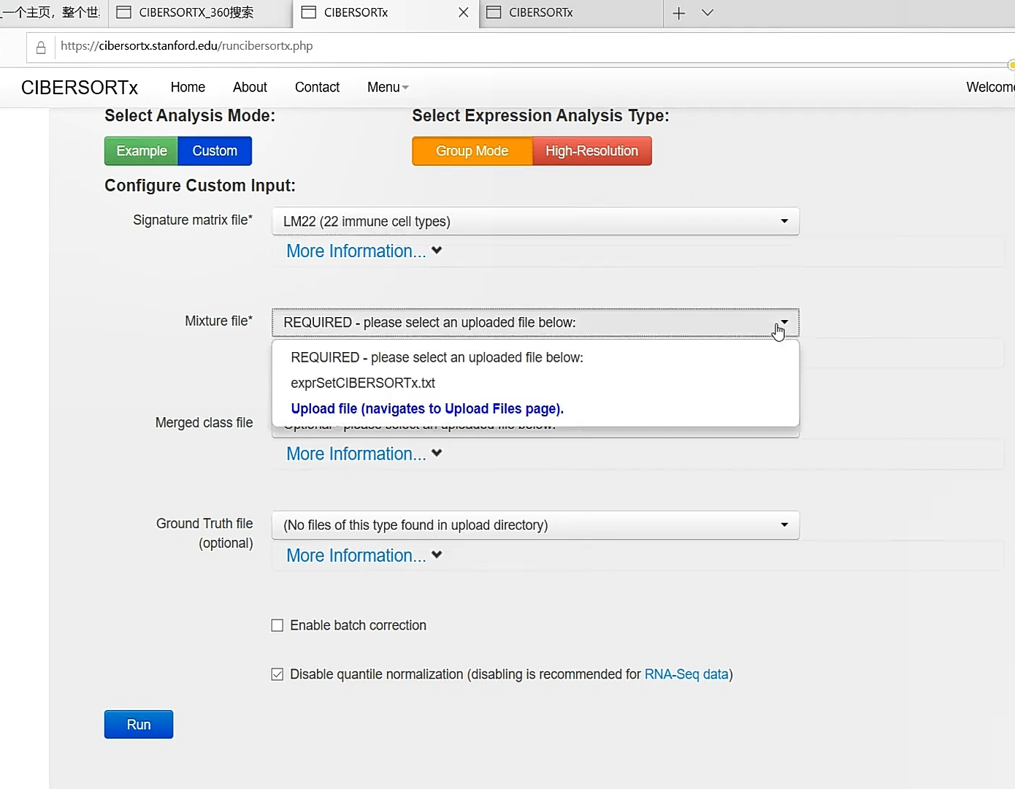

Slide 45
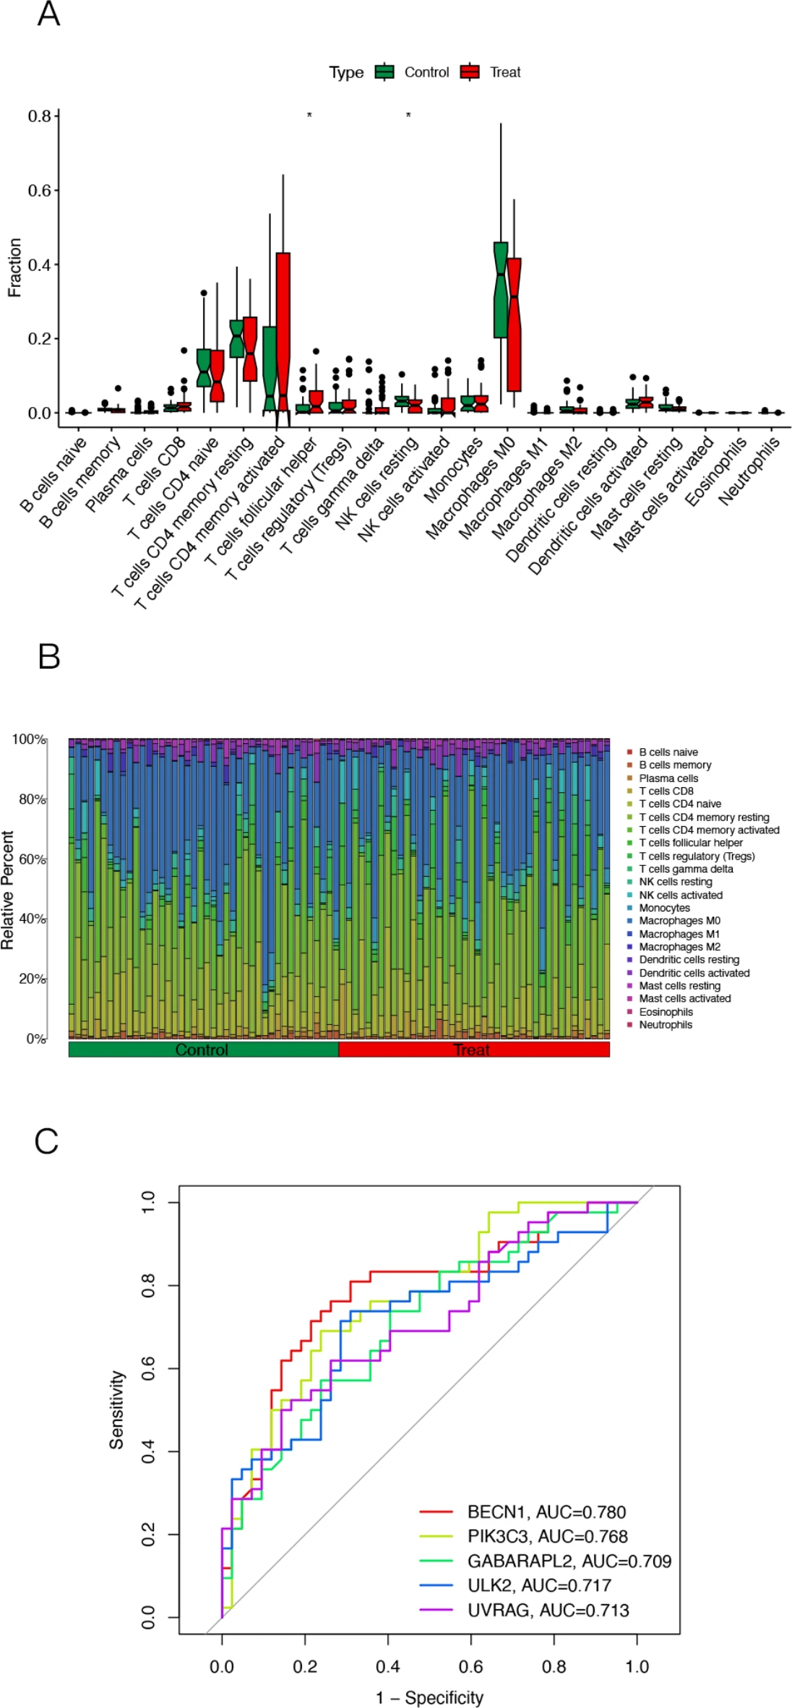

Slide 48
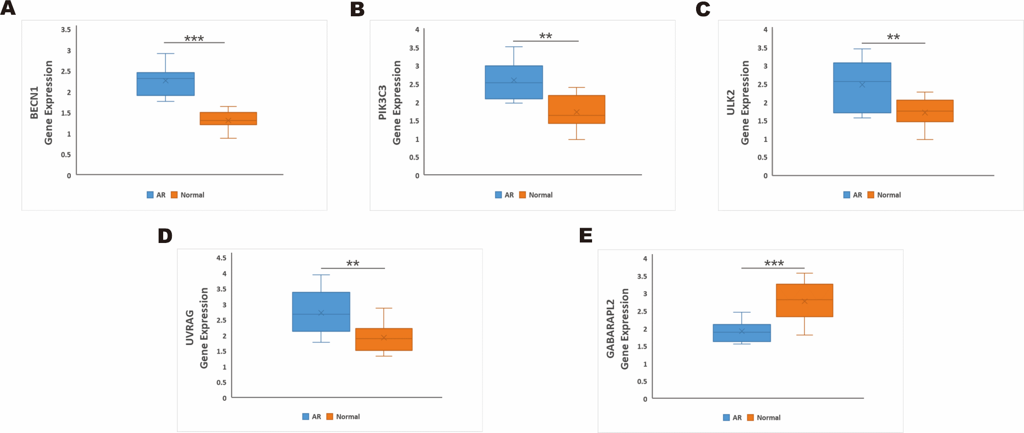

Slide 49
سپاس از همراهی شما

